Slide 1

Is this lack of rain making me (in)sane? Ritualised Trance among Bantu-speaking societies
Hilde Schneemann, Kaius Sinnemäki,
Andrea Bender, Mary Walworth

Slide 2
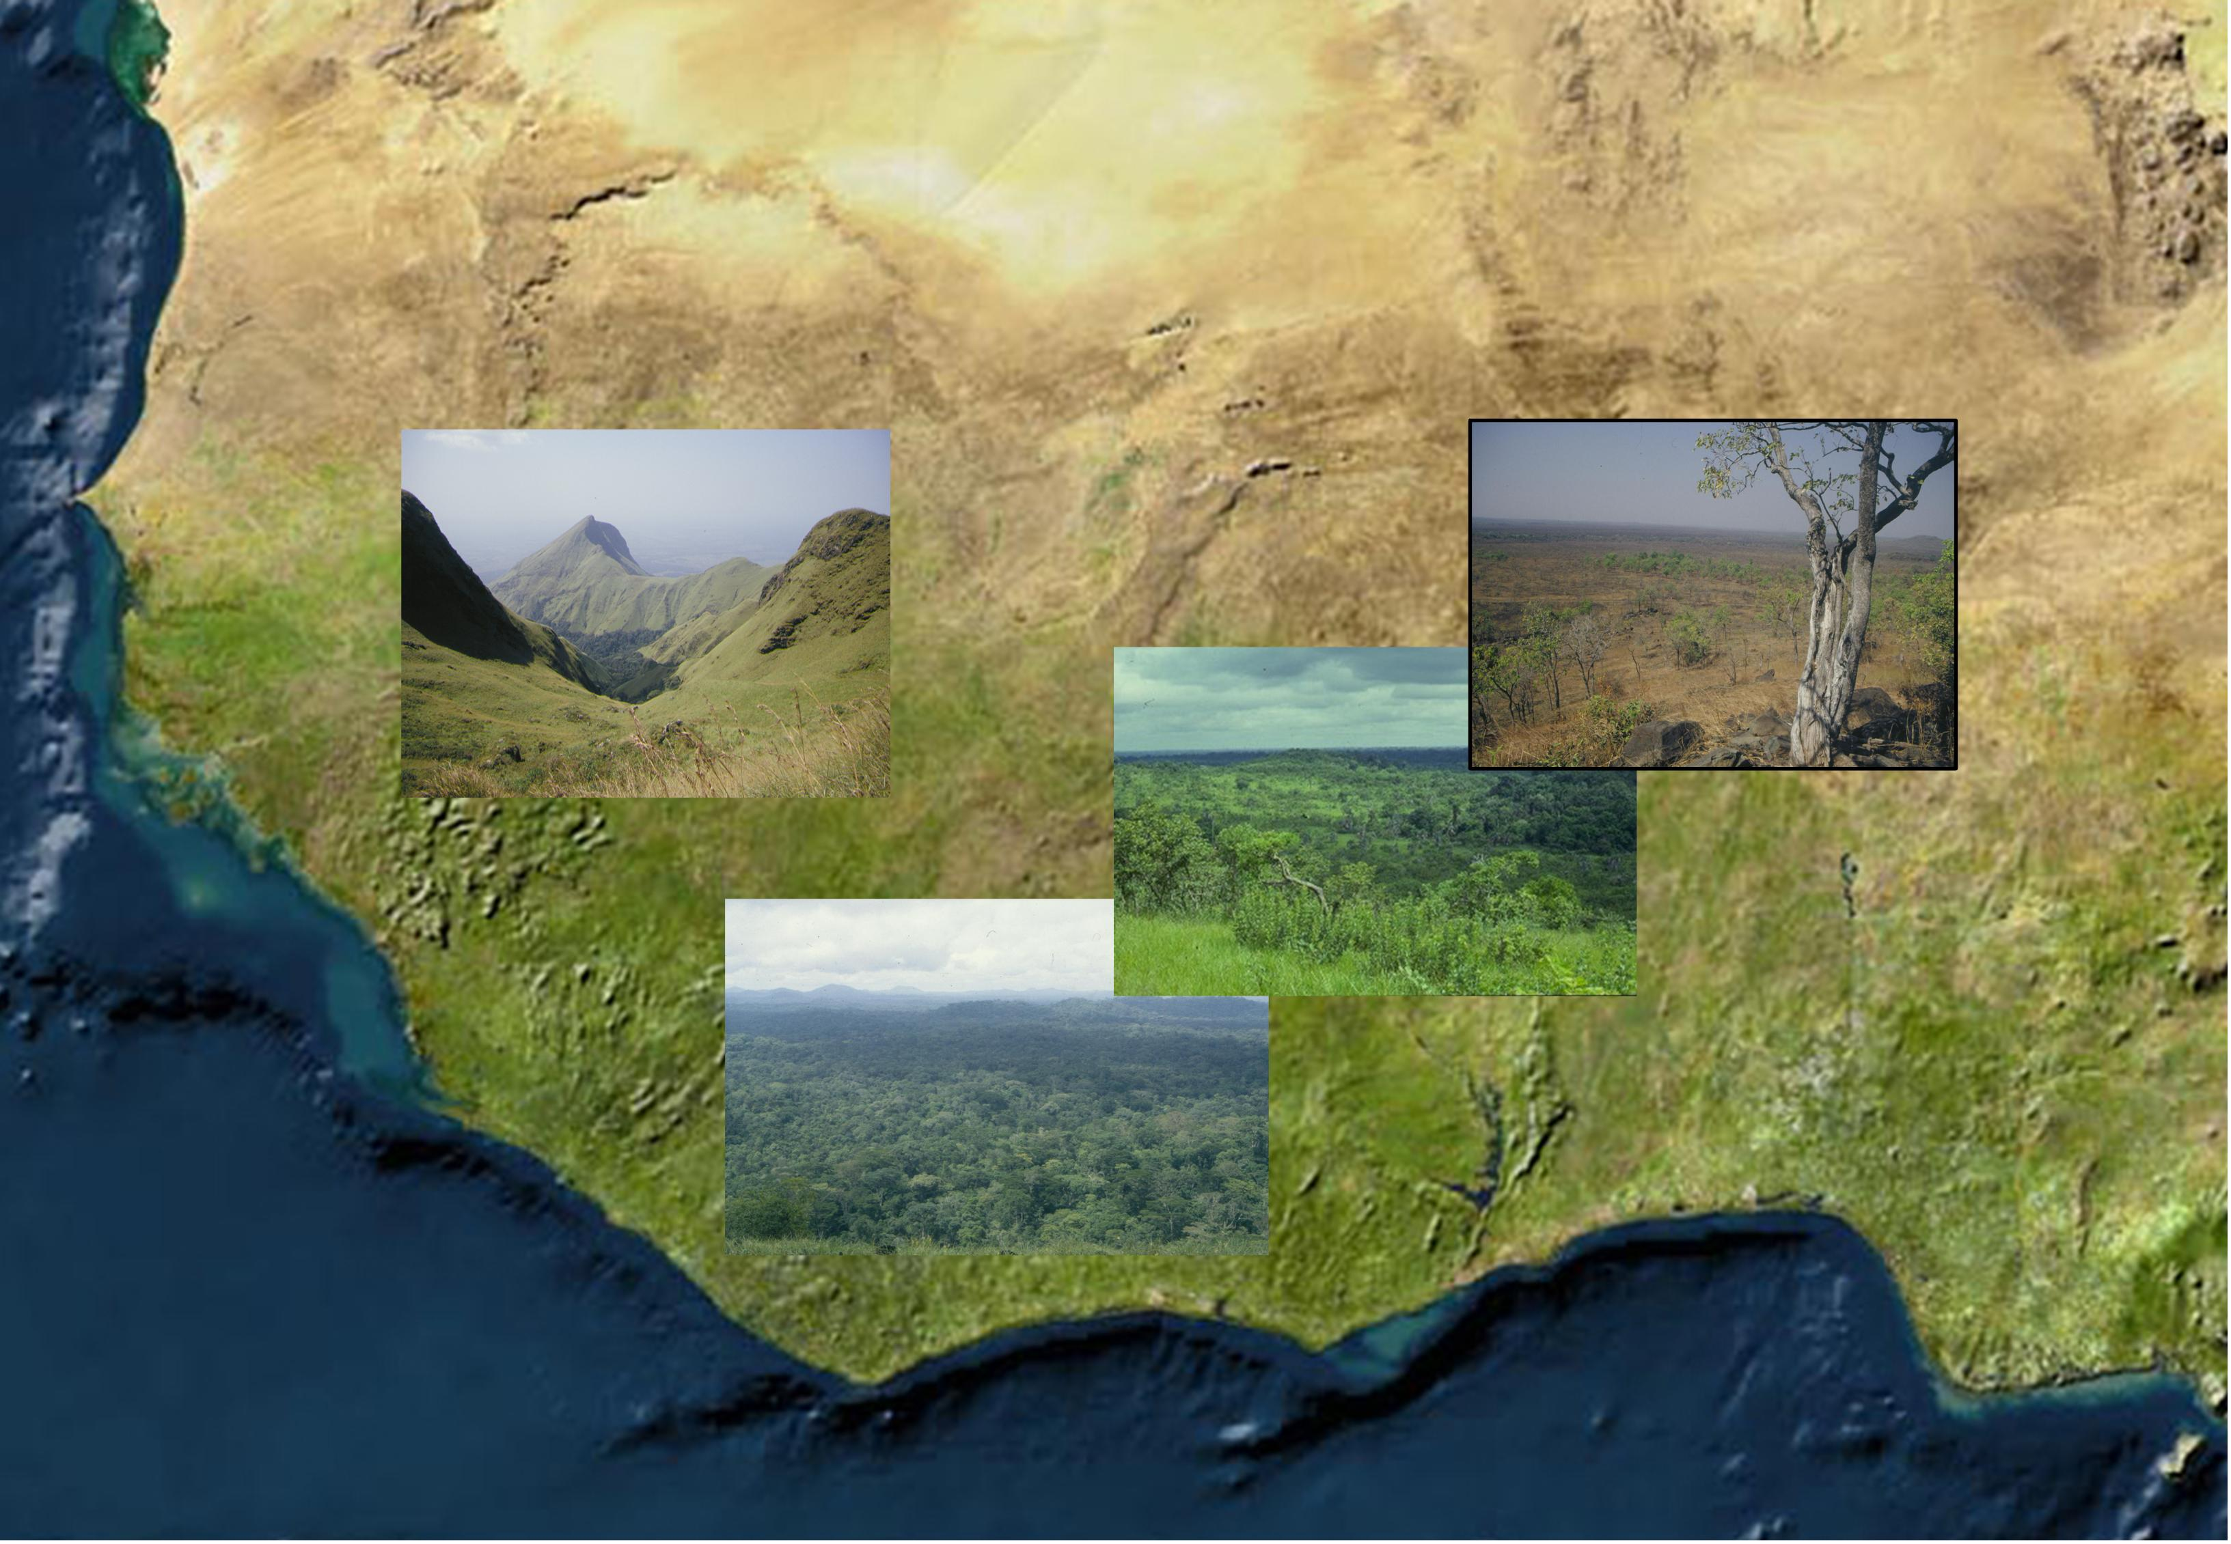
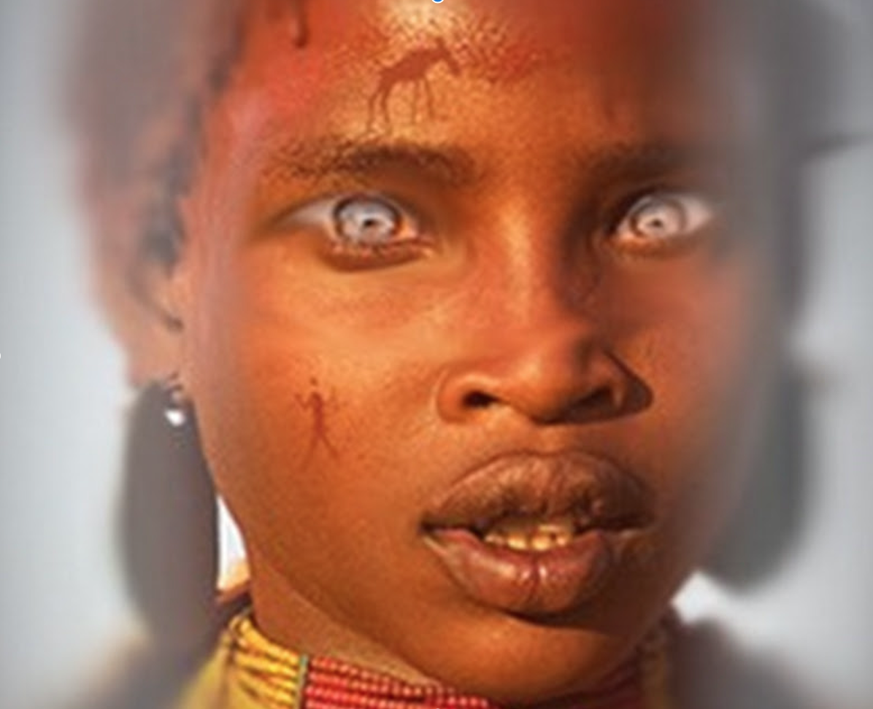
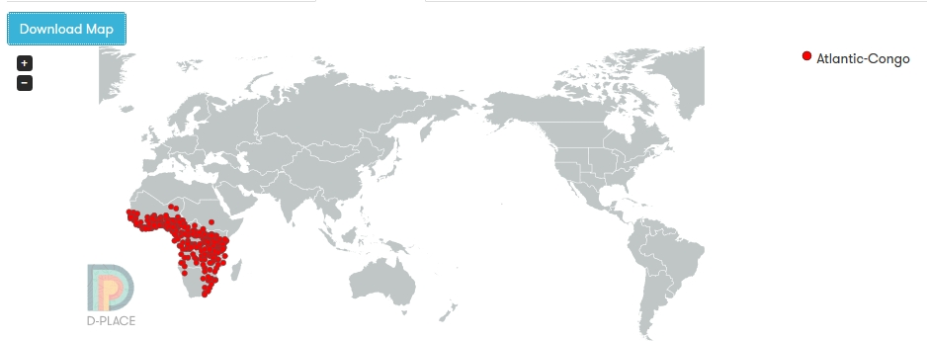
Introduction
Notes:
We decided to look at existence of trance states among Atlantic Congo societies. There is no real reason for this other than we thought trance was an interesting subject matter and we chose Atlantic-Congo because it includes data for a relatively large number of societies that have data for trance-states.

Slide 3
Trance
[https://www.youtube.com/watch?v=K8yzMqWHKqY&t=1s]
Notes:
3:39 to 4:08

Slide 4
Questions/Hypotheses
1: Can we reconstruct ritualised trance to an ancestral state?
(yes/no)
2: Does constancy of rain impact whether a society has ritualised trance?
Yes, societies that are in areas where rain is unpredictable are more likely to have ritualised trance.
Notes:
We wanted to look at this in two ways:
Inheritance
Interaction with the environment
Two questions:
1: Can we reconstruct ritualised trance to an ancestral state?
(yes/no)
2: Does the constancy of rain impact whether a society has ritualised trance?
Yes, societies that are in areas where rain is unpredictable are more likely to have ritualised trance.
(our reasoning is that if you do not know whether you will have rain or not, you may be more likely to use trance to a. connect to and coerce the environment in some metaphysical way, or b. encourage rain from a supernatural force (god, ancestor)

Slide 5
Tools!
D-Place (used for trance and precipitation data; Bantu phylogeny)
Git Repository (used for sanity and sharing data)
R (used for everything…)

Slide 6
Methods
Test for phylogenetic signal:
MCMCglmm
Verification of phylogenetic signal:
Geiger: fitDiscrete
Correlation with precipitation:
MCMCglmm
Notes:
High phylogenetic signal from two independent tests (MCMCglmm and Geiger), using the Bantu phylogenies from D-Place; correlation (MCMCglmm)

Slide 8
Results -

Slide 9
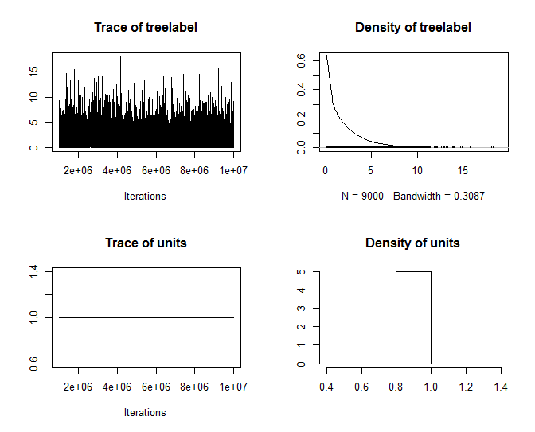
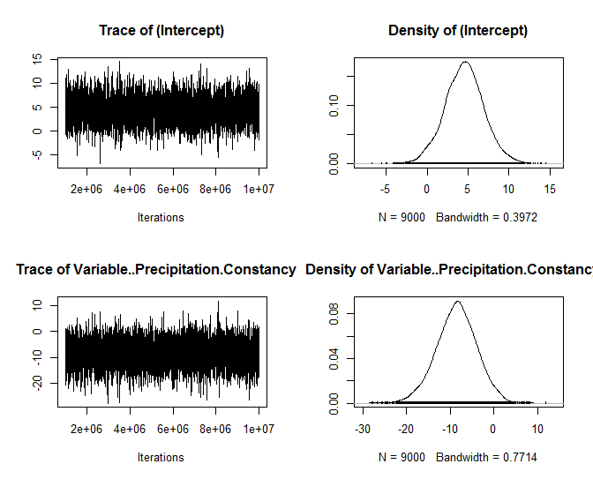
Results - MCMCglmm

Slide 10
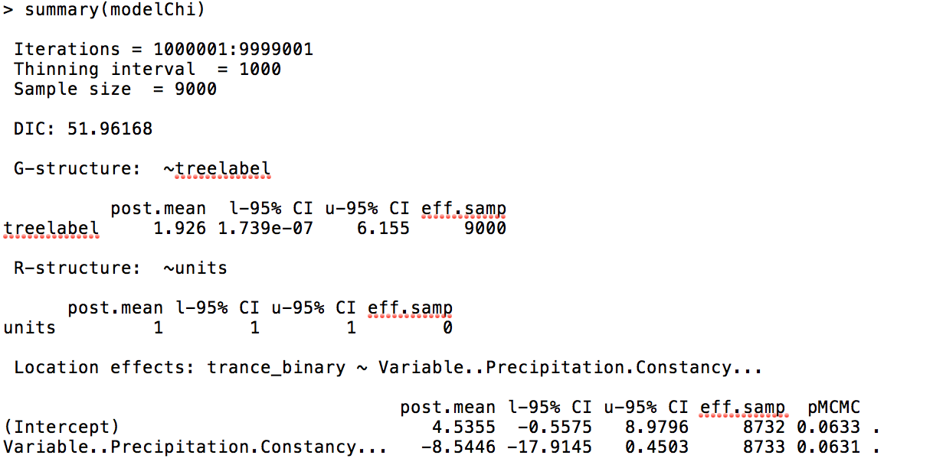
Results – MCMCglmm
Notes:
Negative correlation between rain constancy and the occurrence of ritualised trance which on the borderline of being significant.

Slide 11
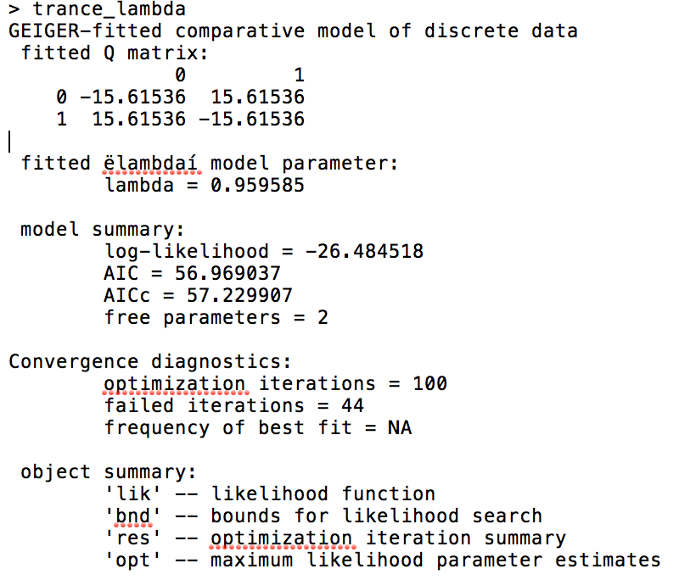
Geiger (continuous time Markov models of trait evolution)
> 1-pchisq(2*(trance_lambda$opt$lnL-trance_lambda0$opt$lnL),1)
[1] 0.05352969

Slide 12
So…
Ritualised trance is culturally inherited.
Lack of rain predictability DOES correlate to ritualised trance (or, we were right).

Slide 13
Final Comments/Discussion
We have a very strong phylogenetic signal, but it doesn’t explain everything, so it is interesting to test other factors.
We chose just one for this project (bc of time constraints) but if this were an actual project, we could look at other possible factors.
Actual rain?
Political structure?
Polygamy? (Mary really wanted to add polygamy to this project in some way…)

